Slide 1
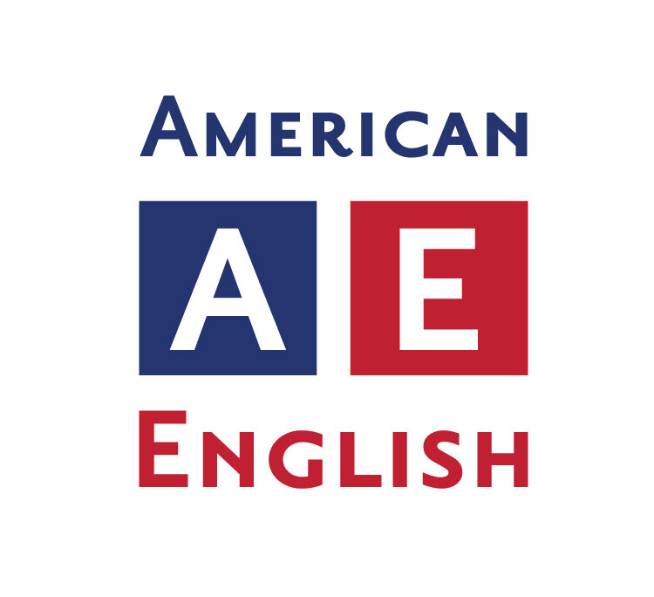
LECTURE I2
English in America

Slide 2
The largest single English speaking area in the world is that formed by the United States and Canada.
Approximately 85 per cent of the 275 million Americans and almost two thirds of the Canadian population of about 31 million had English as their native language.
Many, but by no means all, of the inhabitants of Canada and the United States who do not have English as their first language, nevertheless use it in a multitude of different situations.
The United States does not have an official language despite efforts by the ‘English Only’ movement; however, some 23 states have passed laws making it their official language (see McArthur 2002: 205f.).

Slide 3
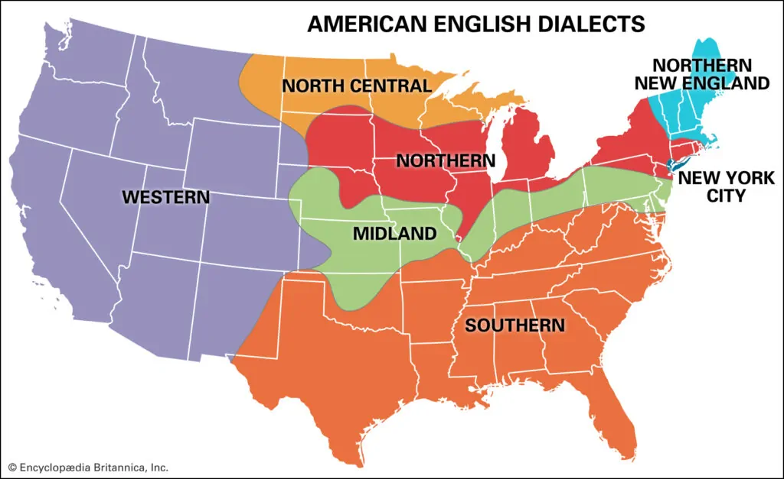
The regional varieties of English in the United States
The regional varieties of English in the United States consist of three general areas (see Map 11.2): Northern, of which CanE is a part, Midland and Southern.

Slide 4
The lexical distinctions are most evident in the more old-fashioned, rural vocabulary which is investigated in the various dialect geographical projects in or related to the ‘Linguistic Atlas of the United States and Canada’.
Pronunciation differences, in contrast to lexis, are evident in everything a person says and less subject to conscious control.
The pronunciation of the Northern Midland area more or less from Ohio westwards, has often been referred to as General American (GenAm). This label is a convenient fiction used to designate a huge area in which there are numerous local differences in pronunciation.

Slide 5
The differences between North Midland and Inland North are relatively insignificant. Both areas are rhotic, are not likely:
Ann → Ian /æ/ → /ı/
bit → bet /ı/ → /ε/
bet → bat / but /ε/ → /Ʌ/
lunch → launch /Ʌ/ → /ɔ/
talk → tuck /ɔ/ → /ɑ/
locks → lax /ɑ/ → /æ/
Rhotic accent (pronounced /r/) speakers pronounce a rhotic consonant r in words like car, bar, far, hard, farm, and first.
Non-rhotic speakers, for example, speakers of British English (BrE) and Australian English do not articulate the /r/ in all of such words.

Slide 6
The most noticeable regional contrast is that between North and South. This division is, in addition to vocabulary and pronunciation differences, underscored to some extent at least by grammatical features.
It seems that it is only in Southern varieties, including Black English Vernacular (or African American Vernacular English), that such admittedly non-standard features occur as perfective done.
(e.g. I done seen it), future gon (I’m gon [not goin’] tell you something)

Slide 7
The dialect which is meant is Appalachian English and the related Ozark English, which are found in the Southern Highlands.
The English of these regions is characterized by a relatively high incidence of older forms which have generally passed out of other forms of AmE.
Examples include syntactic phenomena such as a-prefixing on verbs (I’m a-fixin’ to carry her to town), morphological-phonological ones such as initial /h/ in hit ‘it’ and hain’t ‘ain’t’ and lexical ones such as afore ‘before’ or nary ‘not any’.
Hain't / (heɪnt) archaic, or dialect / contraction of. has not, have not, or is not.

Slide 8
In North America socio-economic status shows up in pronunciation inasmuch as middle class speakers are on the whole more likely than those of the working class to adopt forms which are in agreement with the overt norms of the society.
The now classic investigations of Labov in New York City in the 1960s provided a first insight into these relations (Labov 1972a).
This may be illustrated by the finding that initial voiceless th (as in thing) is realized progressively more often as a stop [t] or an affricate [tθ] than as a fricative [θ] as the classification of the speaker changes from upper middle to lower middle, to working to lower class (Labov 1972b: 188–90).

Slide 9
Social distinctions are especially perceptible in the area of grammar. All of these features are within the scope of GenE.
Nevertheless, a person is regarded as uneducated, unsophisticated and uncouth who uses:
1) ain’t (e.g. I ain’t done it yet)
2) a double modal (I might could help you)
3) multiple negation (We don’t need none)
4) them as a demonstrative (Hand me them cups)
5) no subject relative pronoun in a defining relative clause (The fellow wrote that letter is here)
6) don’t in the third person singular (She don’t like it)
7) was with a plural subject (We was there too early)
8) come, done, seen, knowed, drownded etc. for the simple past tense 9) took, went, tore, fell, wrote etc. as a past participle

